Slide 1
An Introduction to Microprocessor Architecture using intel 8085 as a classic processor http://educate.intel.com/en/TheJourneyInside/ExploreTheCurriculum/EC_Microprocessors/

Slide 2
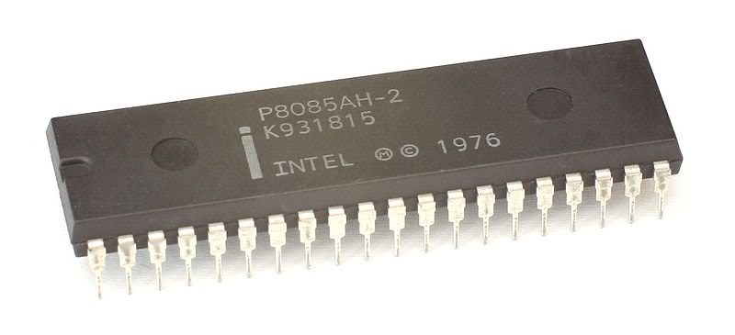
Intel 8085

Slide 3
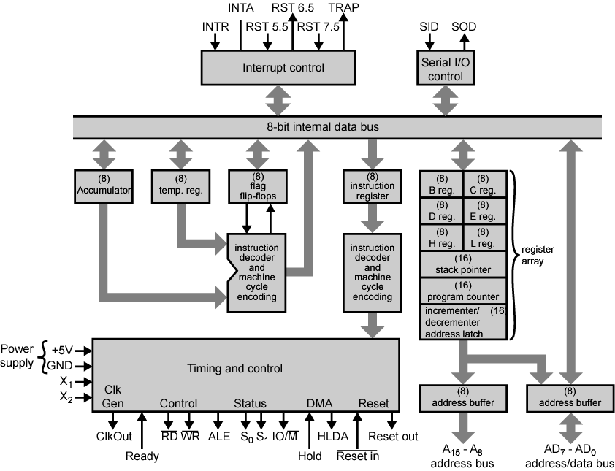
Intel 8085 CPU Block Diagram

Slide 4
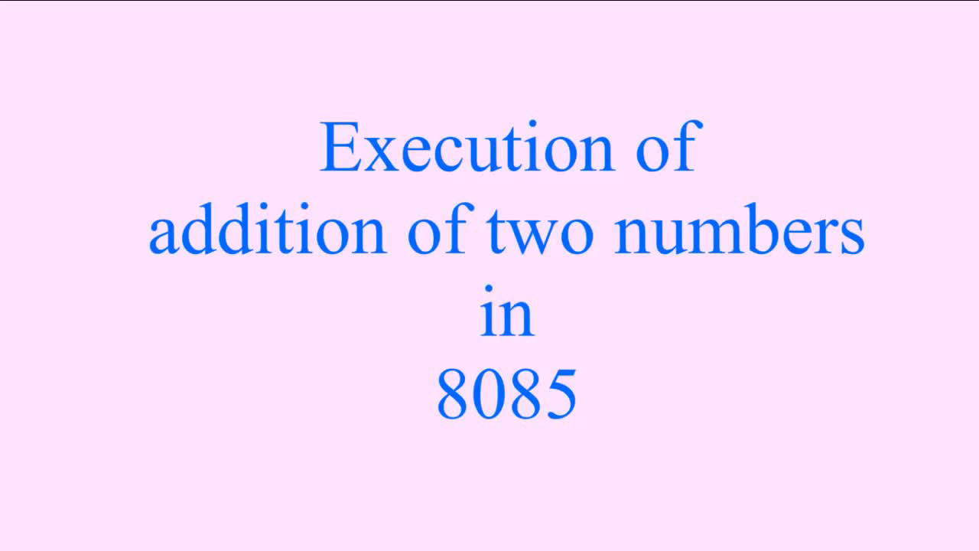

Slide 5
Register group
Arithmetic and logical section
Instruction register , decoder and control group
Address and Address/Data buffers
Interrupt control group
Serial I/O group.

Slide 6
Register Group
It consists of PIPO registers.
The register contain a set of binary storage cell/filp flop with reading Writing facilities.
It is used for temporary storage of instructions and data/address hence, The number of bits in a register is equal data/address/instruction size
The architecture of 8085 consists of three types of registers.
Temporary registers.
General purpose register
Special purpose register

Slide 7
Program Counter- Special purpose register
This 16-bit register deals with sequencing the execution of instructions.
This register is a memory pointer.
The function of the program counter is to point to the memory address from which the next byte is to be fetched.
When a byte is being fetched, the program counter is automatically incremented by one to point to the next memory location

Slide 8
Stack Pointer- Special purpose register
Stack Pointer (SP) The stack pointer is also a 16-bit register, used as a memory pointer.
It points to a memory location in R/W memory, called stack.
The beginning of the stack is defined by loading 16-bit address in the stack pointer.

Slide 9
8-bit Accumulator-Special
purpose register
It is an 8-bit general purpose register of 8085 but it has
some special function that’s why is called special purpose
register
It has to private one of the operand for any ALU operations.
It has to accumulate the result of ALU operations.
It also works as a via register for I/O accesses i.e. whenever
a data is read from input devices , it accumulator and similarly
output device gets data from accumulator.

Slide 10
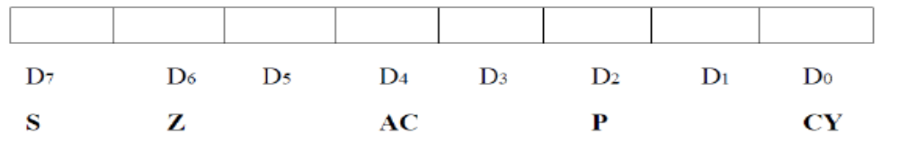
Flag register- Special purpose register
The Flag register of 8085 consists of five flag. They are connected to ALU
When an operation is performed by ALU the result is transferred on internal data bus and status of result will be stored in flip flops.

Slide 11
The Flags register
  There is also a flag register whose bits are affected by the arithmetic & logic operations.
    S-sign flag
      The sign flag is set if bit D7 of the accumulator is set after an arithmetic or logic operation.
    Z-zero flag
      Set if the result of the ALU operation is 0. Otherwise is reset. This flag is affected by operations on the accumulator as well as other registers. (DCR B).
    AC-Auxiliary Carry
      This flag is set when a carry is generated from bit D3 and passed to D4 . This flag is used only internally for BCD operations.
    P-Parity flag
      After an ALU operation, if the result has an even # of 1s, the p-flag is set. Otherwise it is cleared. So, the flag can be used to indicate even parity.
    CY-carry flag
      This flag is set when a carry is generated from bit D7 after an unsigned operation.
    OV-Overflow flag
      This flag is set when an overflow occurs after a signed operation.

Slide 12
Instruction register- Special purpose register
This register is not accessible to the user.
It is not programmable and can not be accessed through any
Instruction
It is part of the ALU

Slide 13
Address Buffer , Address/Data
Buffer and Increment/Decrement
Address Buffer:
This is 8-bit unidirectional buffer used for address lines.
These are used to drive the higher order address bus
Address/Data Buffer:
This is 8-bit bidirectional buffer used for address and data lines.
These are used to drive the lower order address and data bus
Increment/Decrement register:
This is 16 bit register
It is used to increment or decrement address.

Slide 14
ALU:
It perform arithmetic and logical operations
It include accumulator ,temporary register and five flag registers.
The ALU is not available to the user.
Its ward length depends upon the width of an internal data bus i.e. 8-bit
The ALU is always controlled by timing and control circuits.
It accepts operand from accumulator and temporary register.
It stores results of arithmetic and logic operation in accumulator.
It provide status of result to flag register

Slide 15
Timing and Control section
It is made up of synchronous sequential logic circuit.
It control all internal and external circuits in the microprocessor
It operate with reference to clock signal
It accept information from instruction decoder and generate micro steps to perform it.
The control unit also generates timing signals essential for microprocessor to operate.

Slide 16
Interrupt section
It is a mechanism by which an I/O device or an instruction can suspend the normal execution of the processor and get itself serviced is called Interrupt.
This block accepts different interrupt request inputs such as TRAP, RST 7.5, RST 6.5, RST 5.5 and INTR
INTA is an acknowledge pin for mask able and non- mask able interrupt request.

Slide 17
Serial I/O control group:
This data transferred on to data bus is parallel data , but under certain condition it is advantage to use serial data transfer.
8085 implements by SID and SOD signals.
SID line is used to received the data serially and SOD line is used to send data serially.
The data on these line is accepted or transferred under software control

